Slide 1
Mines, Minerals, and Minecraft
Dr. Charles “Chuck” Bell
Lesson 4: 13 February 2019

Slide 2
Agenda
Bible Study: 10-15 minutes
The Raspberry Pi: 5-10 minutes
Hacking Minecraft with Python: 30-45 minutes
Introduction to Python Programming
Example Project: Steve the Iceman!

Slide 3
Bible Study
Gems in the Bible

Slide 4
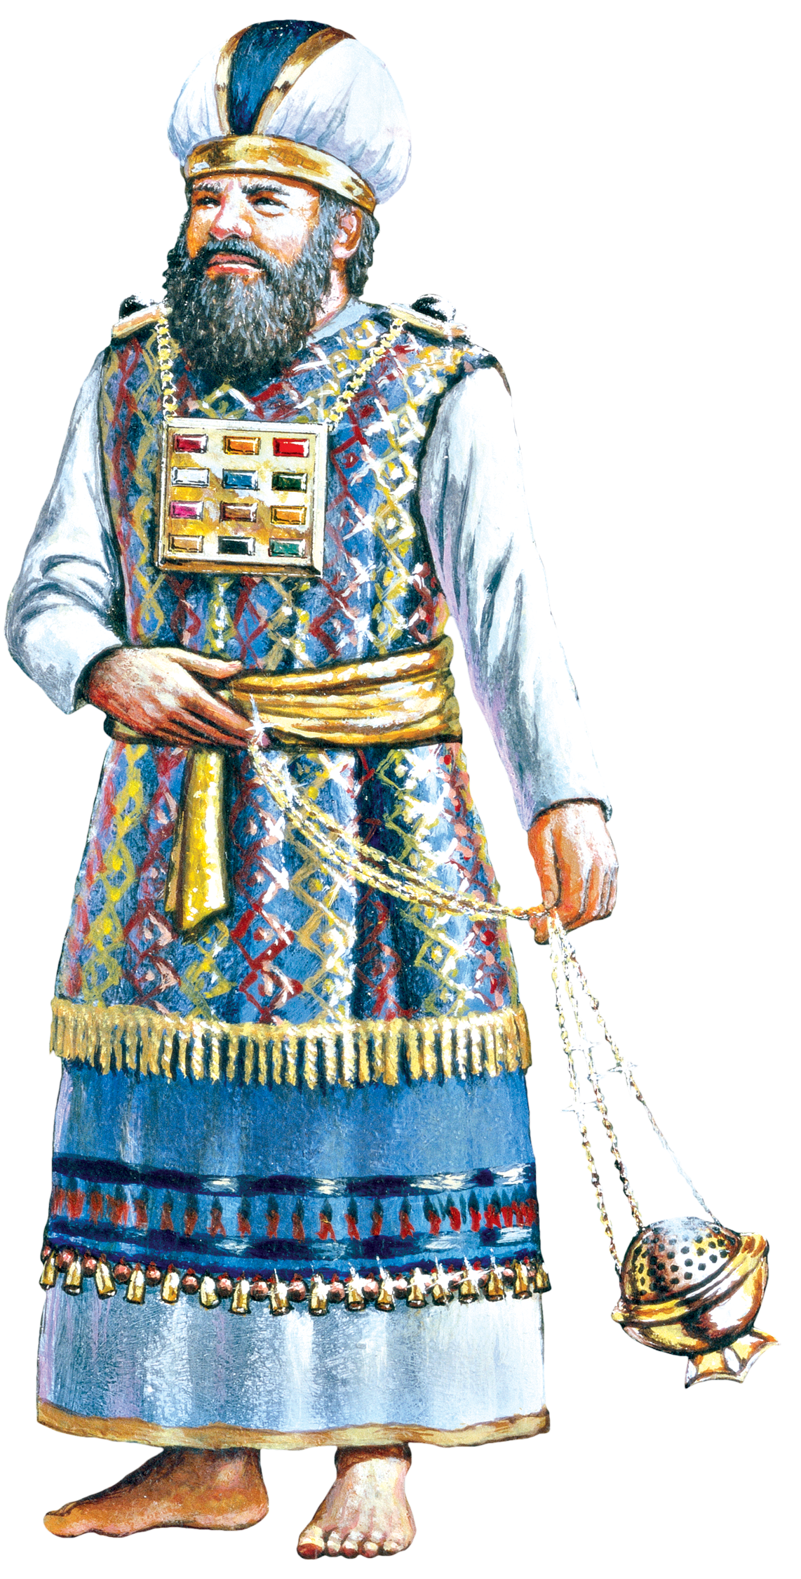
The High Priest
The high priest’s life was dedicated to serving the Lord and representing the people before their God.
The design of the priestly garments was an expression of God’s righteousness and merciful love for his people.
Exodus 28:1–43; 39:1–31

Slide 5
The High Priest
Tunic: The priest dressed first in a checkered tunic of fine linen (Exodus 28:39).

Slide 6
The High Priest
Robe: Over the tunic, the priest wore a blue robe with golden bells and pomegranates (Exodus 28:31–34).

Slide 7
The High Pirest
Ephod: Over the robe, the priest wore an ephod of gold, of blue, purple ,and crimson yarns, and of fine twisted linen (Exodus 28:4–6).

Slide 8
The High Priest
Breastplate and Urim and Thummim: The gold breastplate of judgment hung from chains of pure gold, twisted like cords. In the breastplate were the Urim and Thumim.

Slide 9
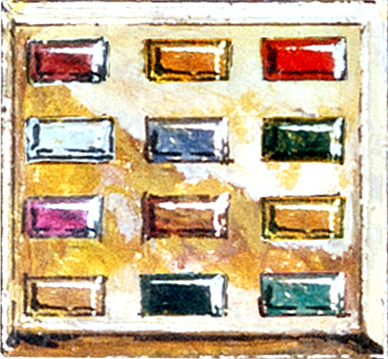
The High Priest
Stones: Inside the breastplate were twelve stones representing the twelve tribes of Israel (Exodus 28:17–21).

Slide 10
The High Priest
Stones: The first row of stones were a carnelian, a chrysolite, and an emerald; the second row were a turquoise, a sapphire, and a moonstone; the third row were a jacinth, an agate, and an amethyst; and the fourth row a beryl, an onyx, and a jasper (Exodus 28:17–21).

Slide 11
The High Priest
Shoulder Stones: Set upon the shoulder pieces of the ephod are two onyx stones. The names of the sons of Israel (six names on each stone) are engraved upon the onyx stones (Exodus 28:9-12; 39:6–7).

Slide 12
The High Priest
Mitre (Turban): The high priest wore a mitre or turban on his head made of fine linen (Exodus 28:4, 39).

Slide 13
The High Priest
The Holy Plate: A holy plate or crow (diadem) was worn on the turban. Engraved on the plate reads: “Holy to the Lord” (Exodus 28:36; 29:6).

Slide 14
The High Priest
The Censer: On the Day of Atonement, the high priest fills a censer full of coals from the altar as well as crushed incense, and brings it into the Most Holy Place and offers it before the Lord (Leviticus 16:12–13).

Slide 15
The High Priest
Jesus is our high priest. He is righteous and merciful, and was willing to sacrifice his life for us and now he lives to intercede for us.
The Bible says that anyone is saved if they go to God through Jesus Christ (Hebrews 7:25).

Slide 16
The Raspberry Pi - Accessories

Slide 17
Accessories
There are several companies that make accessories for the Raspberry Pi beyond the Raspberry PI foundation.
Cases
Cameras
Hats, pHats, GPIO adapters
Screens and Displays
Project Kits

Slide 18
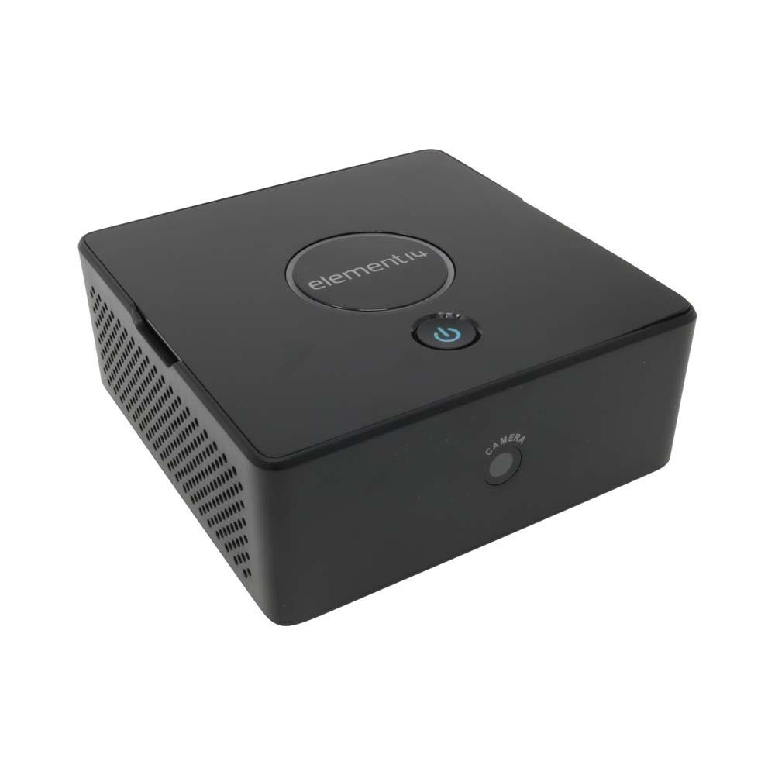
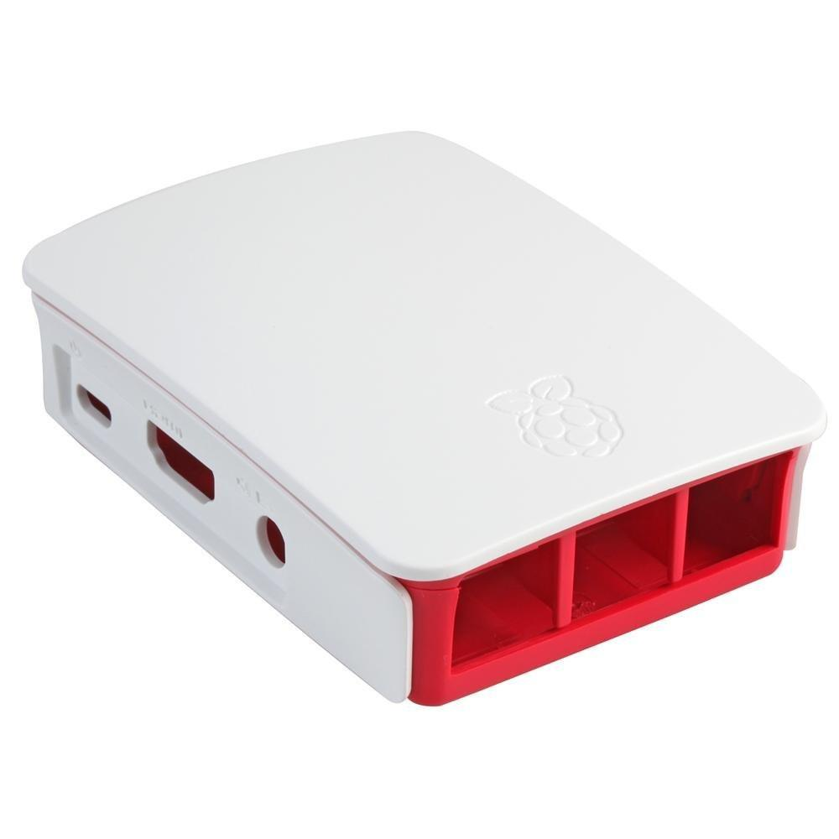
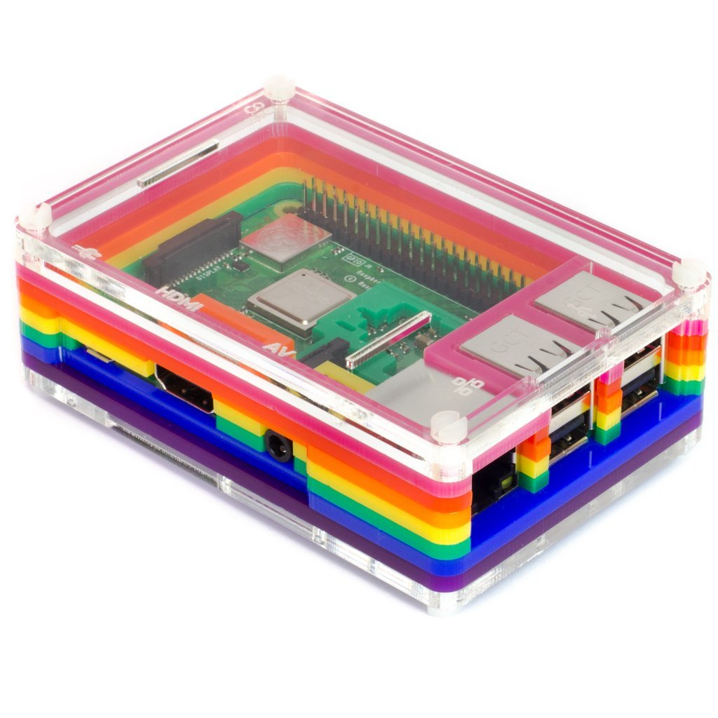
Cases
You can get cases for a variety of uses from general protection to home audio/visual solutions to weather proof enclosures for outdoor use.

Slide 19
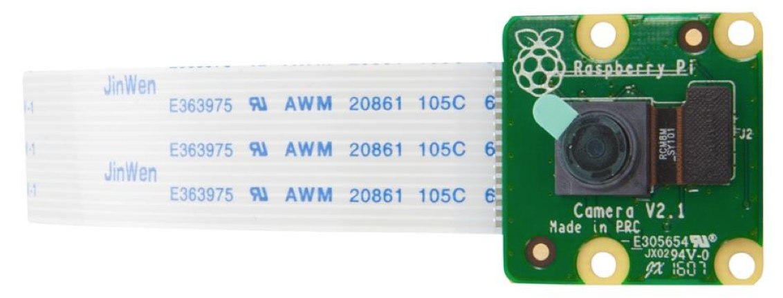
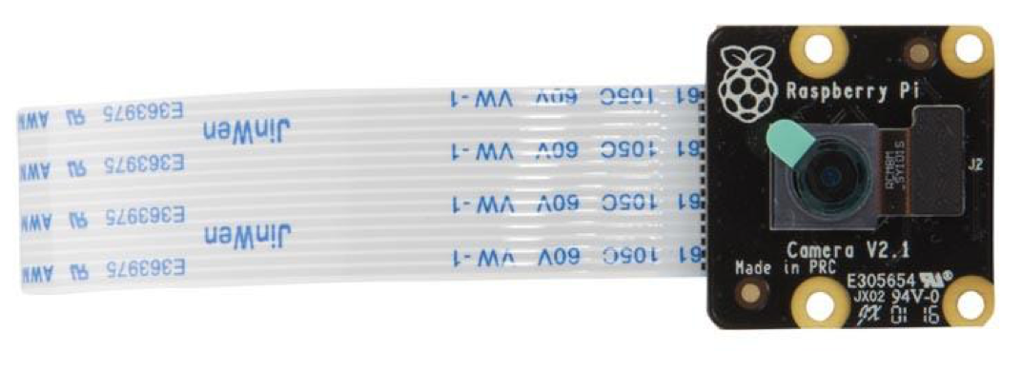
Cameras
There are official cameras including one that uses infrared sensors.
Connect to the Raspberry Pi via a flexible cable.

Slide 20
Hats, pHats, GPIO adapters
A hat plugs into the GPIO header on top.
pHats were coined by Adafruit and tend to be smaller boards that also plug into the GPIO header.
Provide additional hardware capabilities for the board.
Audio
Video
Wireless Radios
GPS
And more!

Slide 21
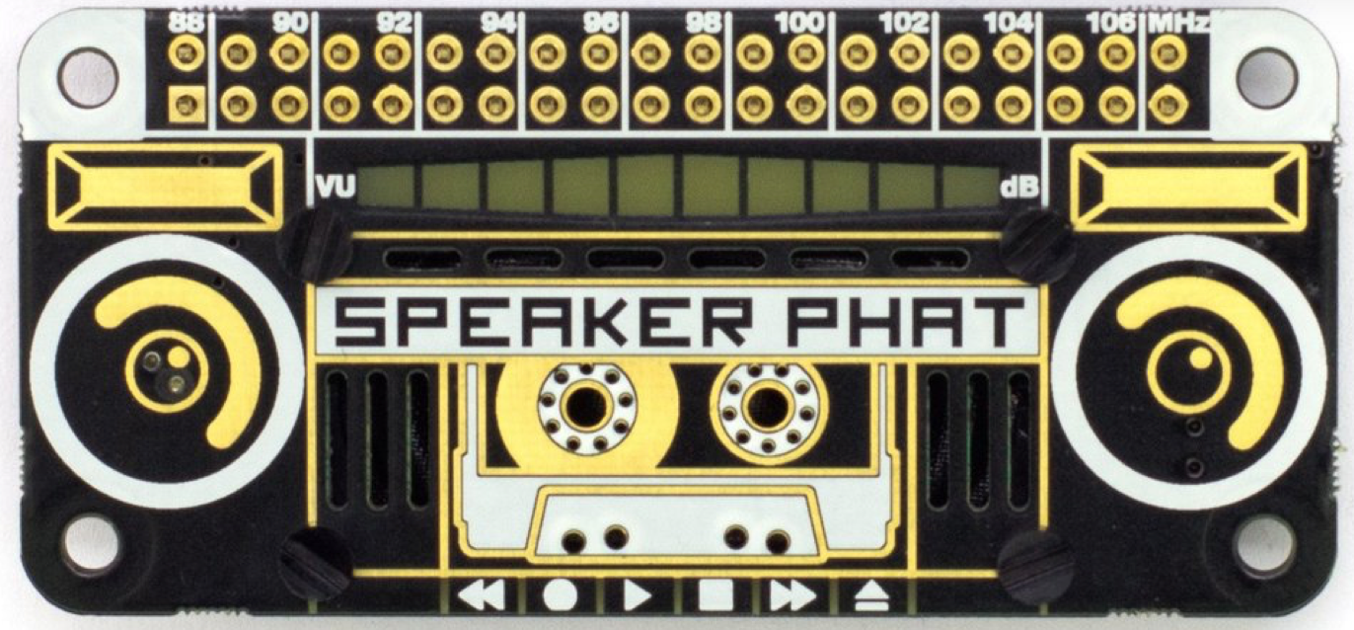
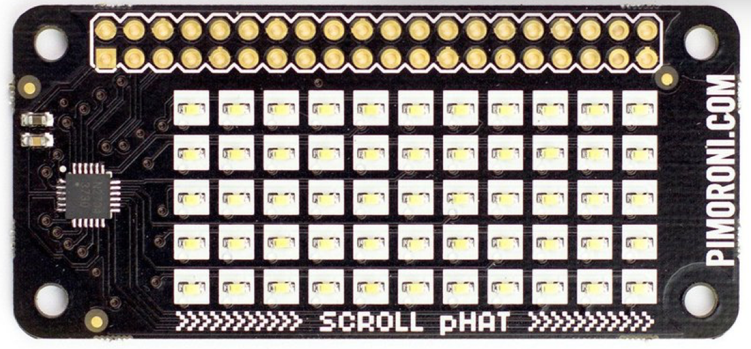
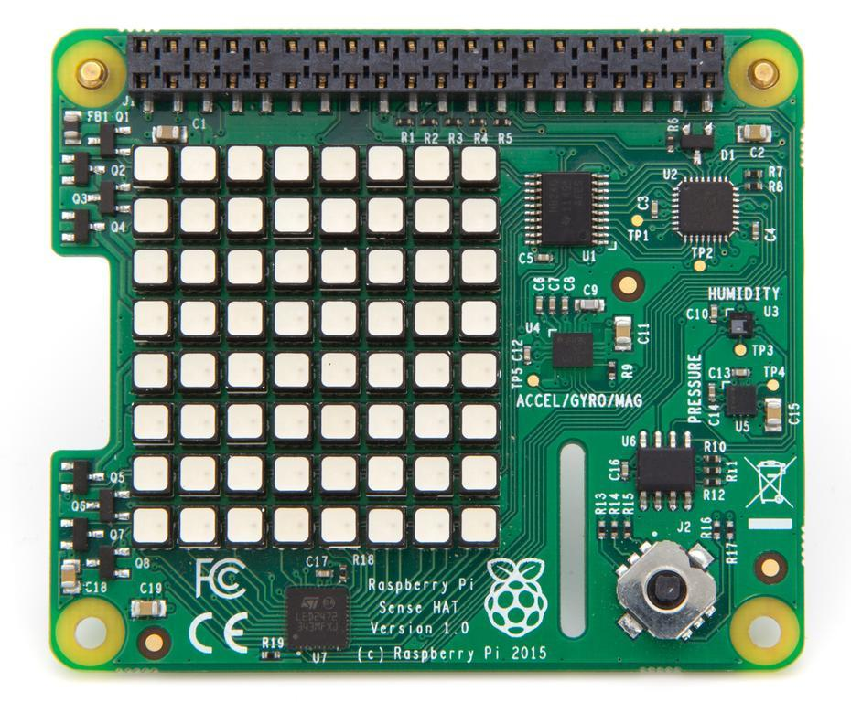
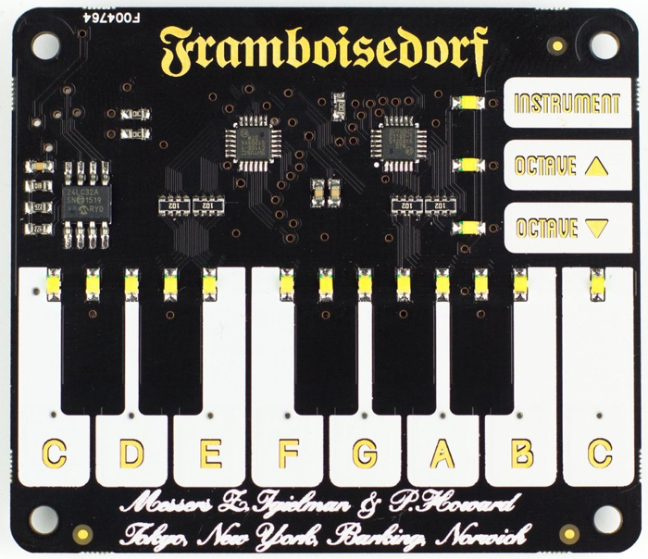
Hats, pHats, GPIO adapters

Slide 22
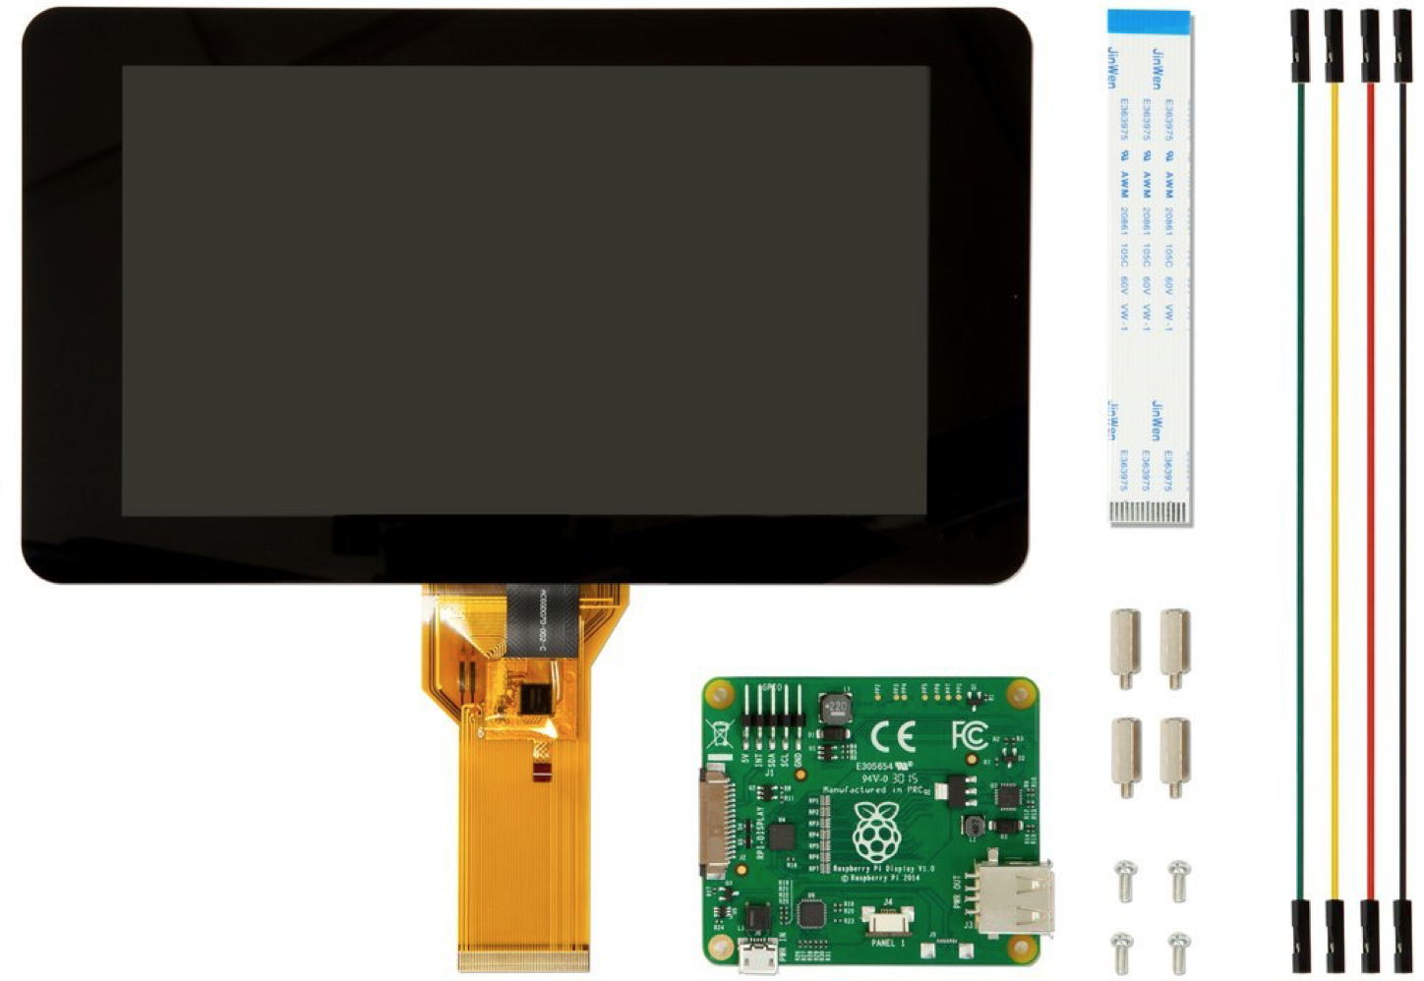
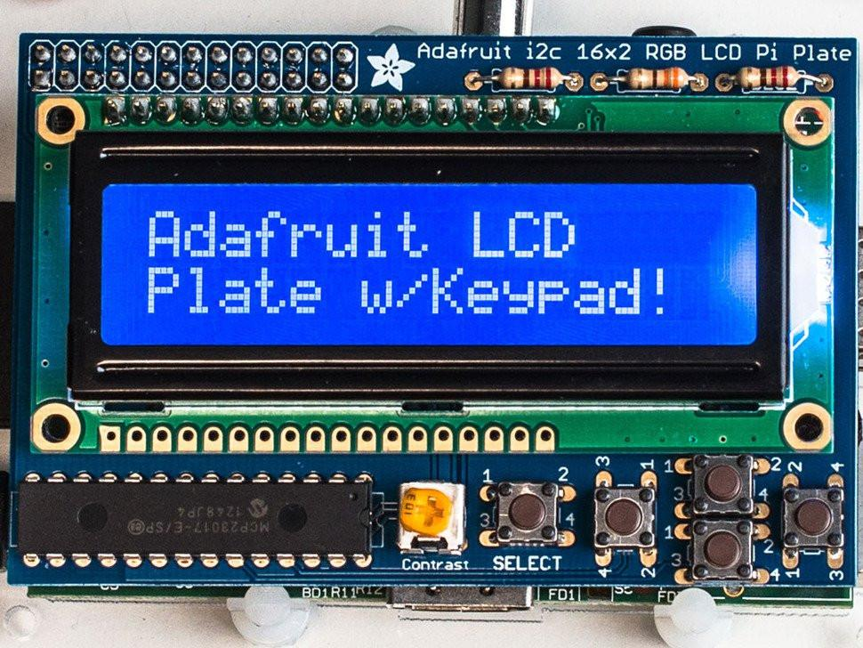
Screens and Displays

Slide 23
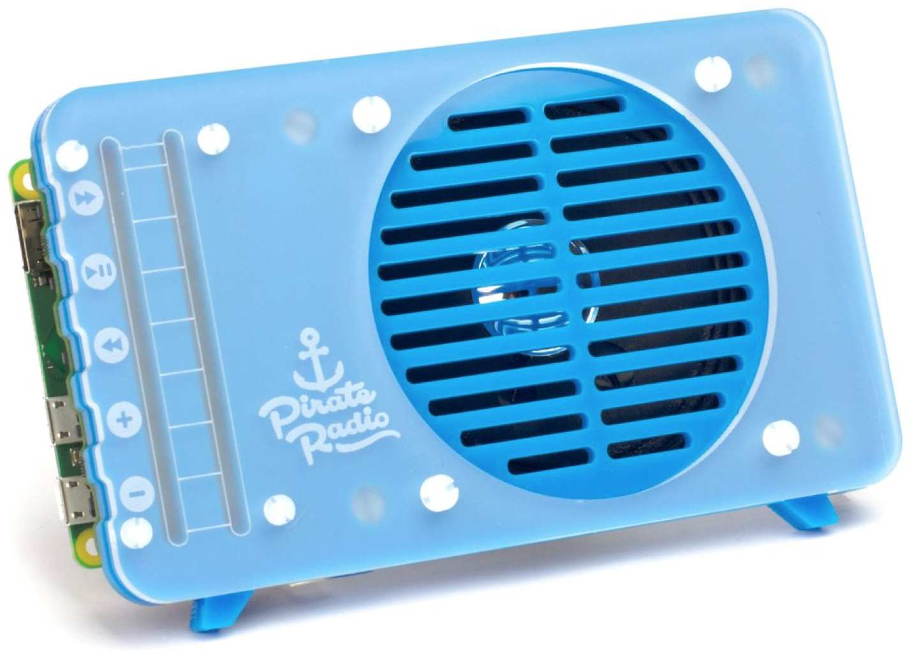
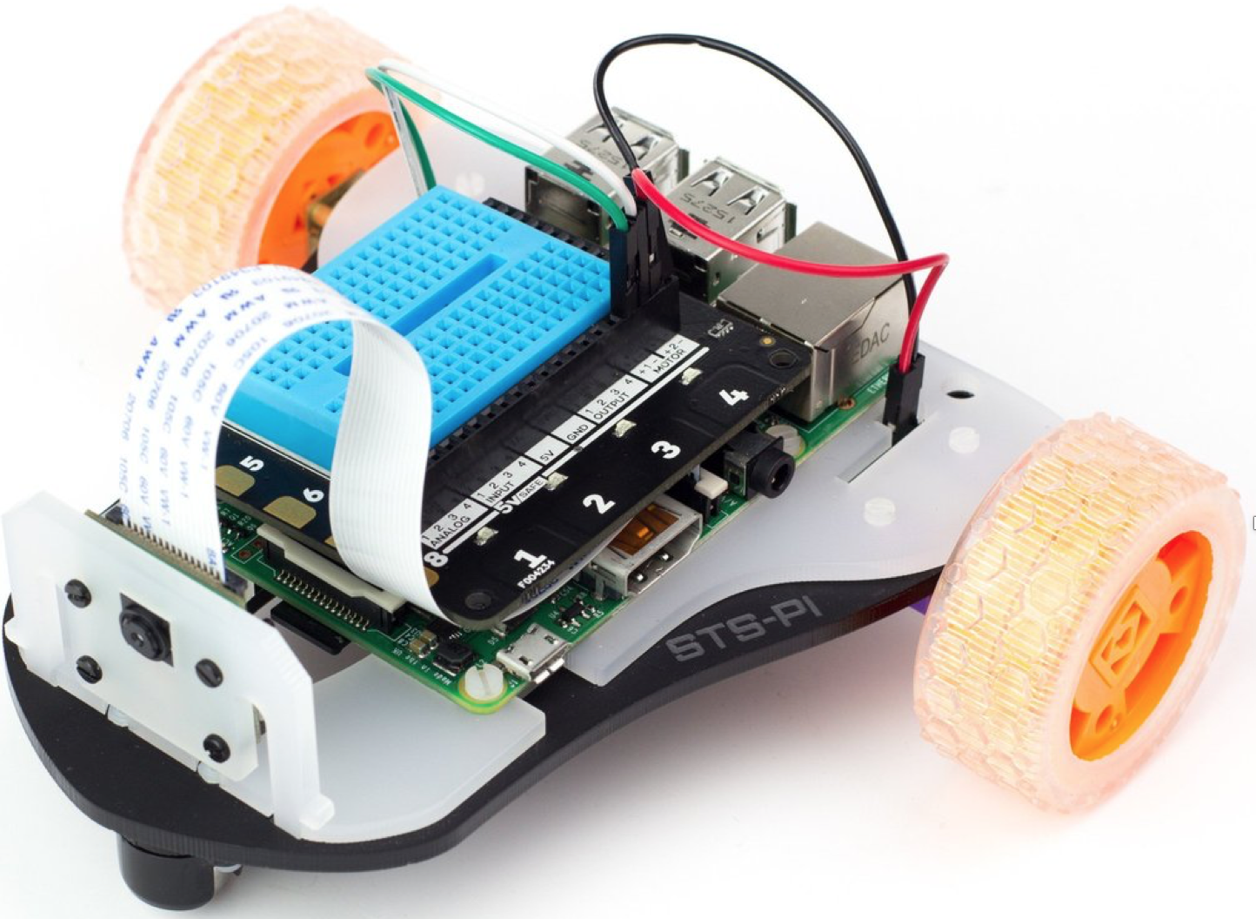
Project Kits
There are many kits available that contain all of the parts you need for your experiment.

Slide 24
Hacking Minecraft with Python

Slide 25
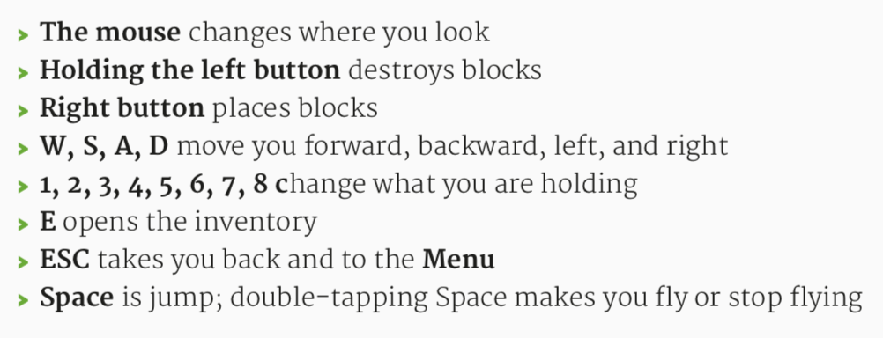
Minecraft Commands

Slide 26
Executing Python Scripts
Working with the Python interactive console is fun, but what a pain it is to have to enter the code over and over again.
There is a better way: Python scripts!
Python scripts are simply files where we store our code.
Files are named with .py file extension.

Slide 27
Python Scripts
Let’s create a folder where we can store our scripts.
Open the command window “terminal”
Type in these commands:
cd ~
mkdir minepi
cd minepi
We will use this folder to place all of our programs.

Slide 28
Controlling Blocks
The Minecraft: Pi Edition API lets you can turn any block in the world into any other block: dirt into diamond, water into lava or stone into air!
By combining functions that get the player’s position with those that change blocks, you can make the world change around the playerwithout them doing anything.

Slide 29
Steve the Iceman
Open IDLE by clicking Menu > Programming > Python 3.
Use File > New Window to create a new program and save it as ‘iceman.py’.
At the top of your program import the minecraft and block modules to use the API:
import mcpi.minecraft as minecraft
import mcpi.block as block
Create a connection from your program to Minecraft and call it mc:
mc = minecraft.Minecraft.create()
Get the player’s ‘tile’ position (the block Steve is standing on), and store it in a variable called p:
p = mc.player.getTilePos()
Use the setBlock() function to change this block to snow:
mc.setBlock(p.x, p.y, p.z, block.SNOW)
Run your program by clicking Run > Run Module.

Slide 30
Code: iceman.py
# iceman.py – Set the tile Steve is on to ice.
from mcpi.minecraft import Minecraft
from mcpi import block
mc = Minecraft.create()
pos = mc.player.getTilePos()
mc.setBlock(pos.x, pos.y, pos.z, block.SNOW)

Slide 31
Steve the Iceman
Go back to Minecraft and look down: the block you’re standing on will now be covered in snow. Make sure you’re standing on the ground and not flying, as you can’t put snow in the air!
Next, let’s change the program so that it loops forever, always getting the player’s position and turning that block to snow; that way, Steve will create snow wherever he walks!

Slide 32
Steve the Iceman
Go back to Python and modify your iceman.py program save it as a new file named ‘iceman1.py’ with File -> Save As
Add a while loop to the bottom of your program. This loop will continue forever: while True:
The rest of your program will be indented under the while loop. If IDLE doesn’t indent the next line for you, press Tab. Add the code to find the player’s position and create the snow block:
while True:
p = mc.player.getTilePos()
mc.setBlock(p.x, p.y, p.z, block.SNOW)
Run your program by clicking Run > Run Module.

Slide 33
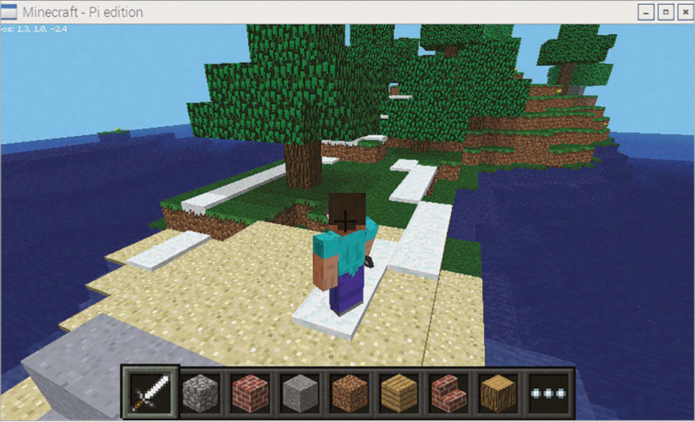
Steve the Iceman

Slide 34
Code: iceman1.py
# iceman1.py – Set every tile Steve walks on
# to ice.
from mcpi.minecraft import Minecraft
from mcpi import block
mc = Minecraft.create()
while True:
pos = mc.player.getTilePos()
mc.setBlock(pos.x, pos.y, pos.z, block.SNOW)

Slide 35
Steve the Iceman
Now, let’s give Steve the power of Jack Frost!
We want to make every block Steve hits to turn to ice and snow. Cool, eh?
When a block is hit with a sword by right-clicking, you can use the API to change those blocks.

Slide 36
Steve the Iceman
Go back to Python and modify your iceman.py program save it as a new file named ‘iceman2.py’ with File -> Save As
At the end of your program, indented under the while loop, add the code to get the blocks which have been hit:
Indented under the for loop, add the code to turn the block which has been hit to
while True:
for hit in mc.events.pollBlockHits():
ice.mc.setBlock(hit.pos.x, hit.pos.y,
hit.pos.z, block.ICE)
Run your program by clicking Run > Run Module.

Slide 37
Code: iceman2.py
# iceman2.py – Set every tile Steve hits
# to ice.
from mcpi.minecraft import Minecraft
from mcpi import block
mc = Minecraft.create()
while True:
pos = mc.player.getTilePos()
mc.setBlock(pos.x, pos.y, pos.z, block.SNOW)
for hit in mc.events.pollBlockHits():
mc.setBlock(hit.pos.x, hit.pos.y,
hit.pos.z, block.ICE)

Slide 38
LAB TIME
Use the remainder of class to explore the sample code (see handout).
Try different values for the blocks and have fun changing the world!
Hint: block.<> (AIR, STONE, GRASS, DIRT, or COBBLESTONE)
You can leave when you’re finished.
DO NOT DISTURB the other classes!
REMEMBER TO SHUTDOWN YOUR RASPBERRY PI
DO NOT POWER IT OFF UNTIL YOU SHUTDOWN

Slide 39
Questions or comments?

